Slide 1
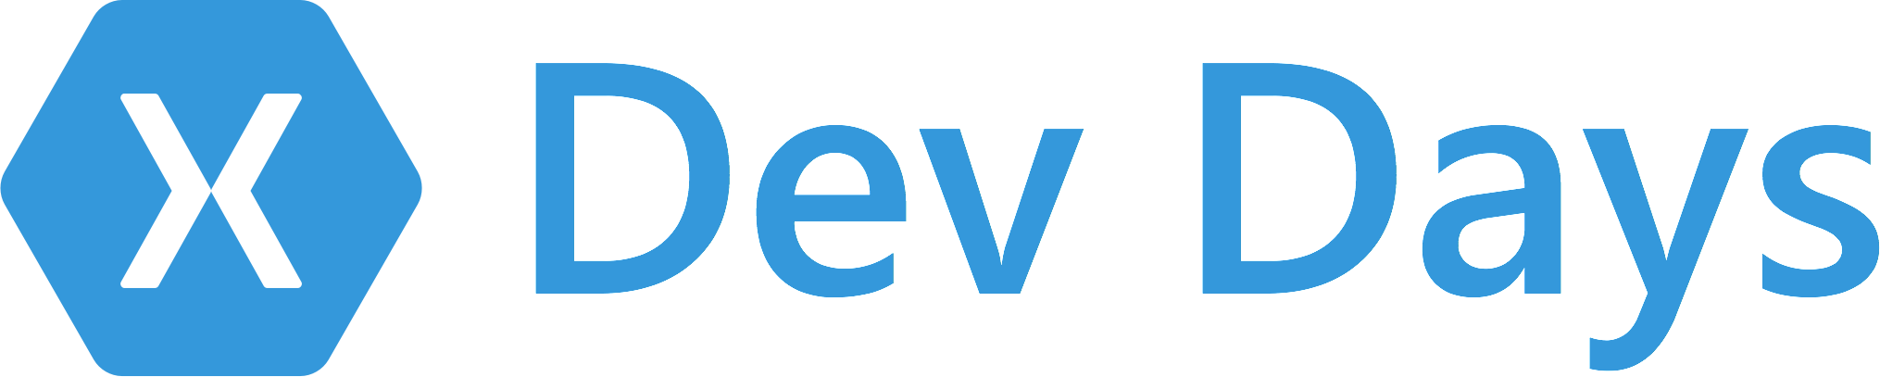

#XamarinDevDays

Slide 2

Agenda
Introduction to Xamarin Miljenko Cvjetko Xamarin/Microsoft
Cross Platform UI with Xamarin.Forms Tino Petrina – Xamarin Certified Developer
Connected Apps with Azure Ivan Čuljak C*O transpose.xyz
Lunch – Courtesy of HolisticWare/Xamarin/Microsoft
Workshop: File -> New App

Slide 3
Slides, Demos, & Lab - Clone or Download:
http://github.com/xamarin/dev-days-labs

Slide 4
Sponsor
Syncfusion.com
#XamarinDevDays

Slide 5
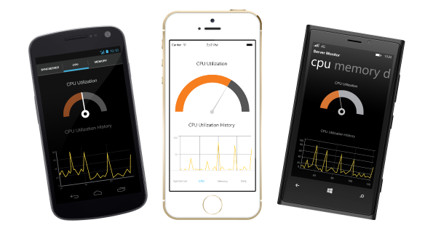

Free Syncfusion License
Essential Studio for Xamarin
Cross-platform mobile development for Xamarin.Forms, Xamarin.iOS, and Xamarin.Android.
Claim your free license at:
www.Syncfusion.com/XamarinDevDays
Deliver innovation with ease

Slide 6
Sponsor
Microsoft.com
#XamarinDevDays

Slide 7


Sponsor
University of Zagreb http://www.unizg.hr/
FER (Faculty of Electrical Engineering and Computing) https://www.fer.unizg.hr/en
IEEE Student Branch http://www.ieee.hr/ieee/english
#XamarinDevDays

Slide 8

Sponsor
HolisticWare d.o.o. (LLC) http://holisticware.net/
#XamarinDevDays

Slide 9

Supporter
https://www.meetup.com/Xamarin-net-mono-Zagreb-Meetup-Group
#XamarinDevDays

Slide 10
Native iOS & Android Development with Xamarin
Presenter Name
Presenter Twitter
Presenter Title

Slide 11






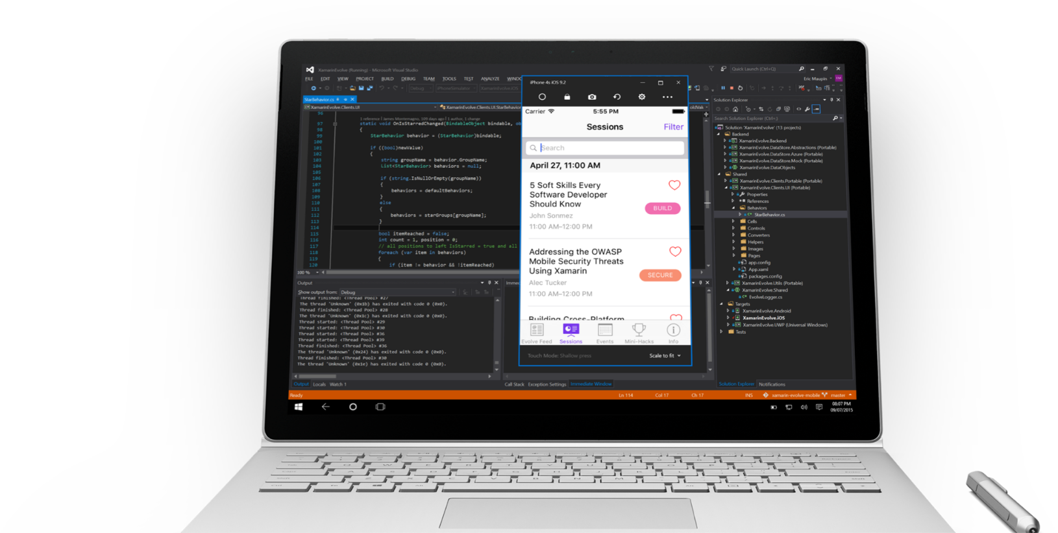
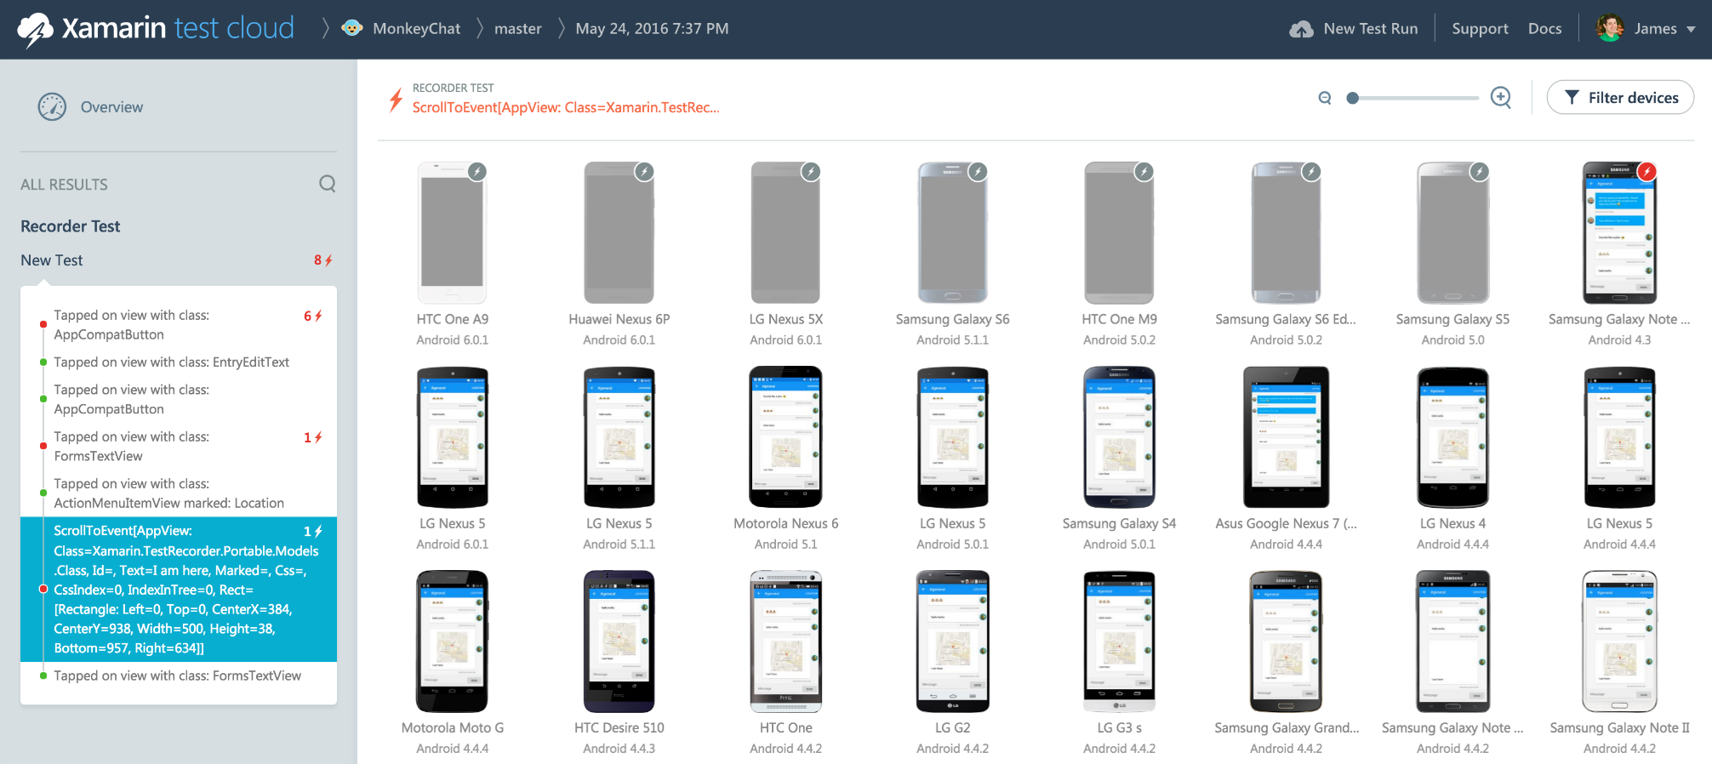
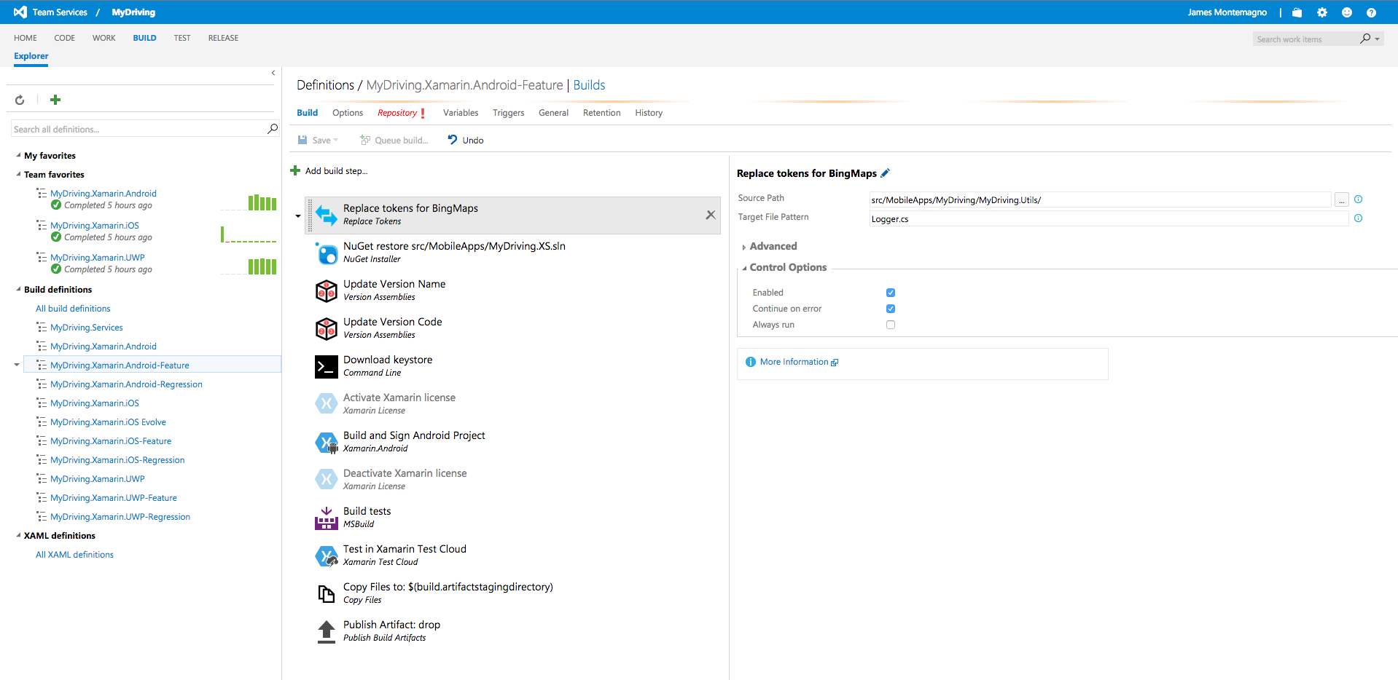
Xamarin – Your Complete Mobile Solution
Develop
Test
Build
Distribute
Monitor
Notes:
Xamarin is your complete mobile solution.
Xamarin Platform is usually what you hear about which is building native iOS, Android, Mac, and Windows Apps all in C#
However Xamarin offers a wide range of products for developers to go mobile including Test Cloud, Hockey App, and a way to learn all of mobile with University.

Slide 12
Architecting Mobile Apps
Notes:
So we know what we want how do we get there? Let’s talk about the state of mobile development.

Slide 13
Silo Approach
iOS
Android
Windows
Objective-C
Xcode
Java
Android Studio
C#
Visual Studio
No shared code • Many languages & development environments • Multiple teams
Notes:
Multiple Teams
Multiple Code Bases
Expensive & Slow
Positive = Great apps delivered to user’s platform
Negative = Development hampered by multiple code bases & fragmentation

Slide 14
Write Once, Run Anywhere
Lua
Javascript
Actionscript
HTML+CSS
App Generator
Limited native API access • Slow performance • Poor user experience
Notes:
Unhappy Users
Unhappy Developers
Increase in Abandoned Apps
Limited to what is implemented

Slide 15
Xamarin’s Unique Approach
iOS C# UI
Android C# UI
Windows C# UI
Shared C# Mobile
Shared C# codebase • 100% native API access • High performance

Slide 16
Windows APIs
Microsoft.Phone
Microsoft.Networking
Windows.Storage
Windows.Foundation
Microsoft.Devices
System.Net
System
System.IO
System.Linq
System.Xml
System.Data
System.Windows
System.Numerics
System.Core
System.ServiceModel

Slide 17
iOS – 100% API Coverage
MapKit
UIKit
iBeacon
CoreGraphics
CoreMotion
System.Net
System
System.IO
System.Linq
System.Xml
System.Data
System.Windows
System.Numerics
System.Core
System.ServiceModel

Slide 18
Android – 100% API Coverage
Text-to-speech
ActionBar
Printing Framework
Renderscript
NFC
System.Net
System
System.IO
System.Linq
System.Xml
System.Data
System.Windows
System.Numerics
System.Core
System.ServiceModel

Slide 19
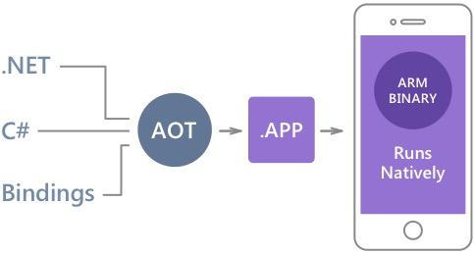
Native Performance
Xamarin.iOS does full Ahead Of Time (AOT) compilation to produce an ARM binary for Apple’s App Store.
Xamarin.Android takes advantage of Just In Time (JIT) compilation on the Android device.

Slide 20
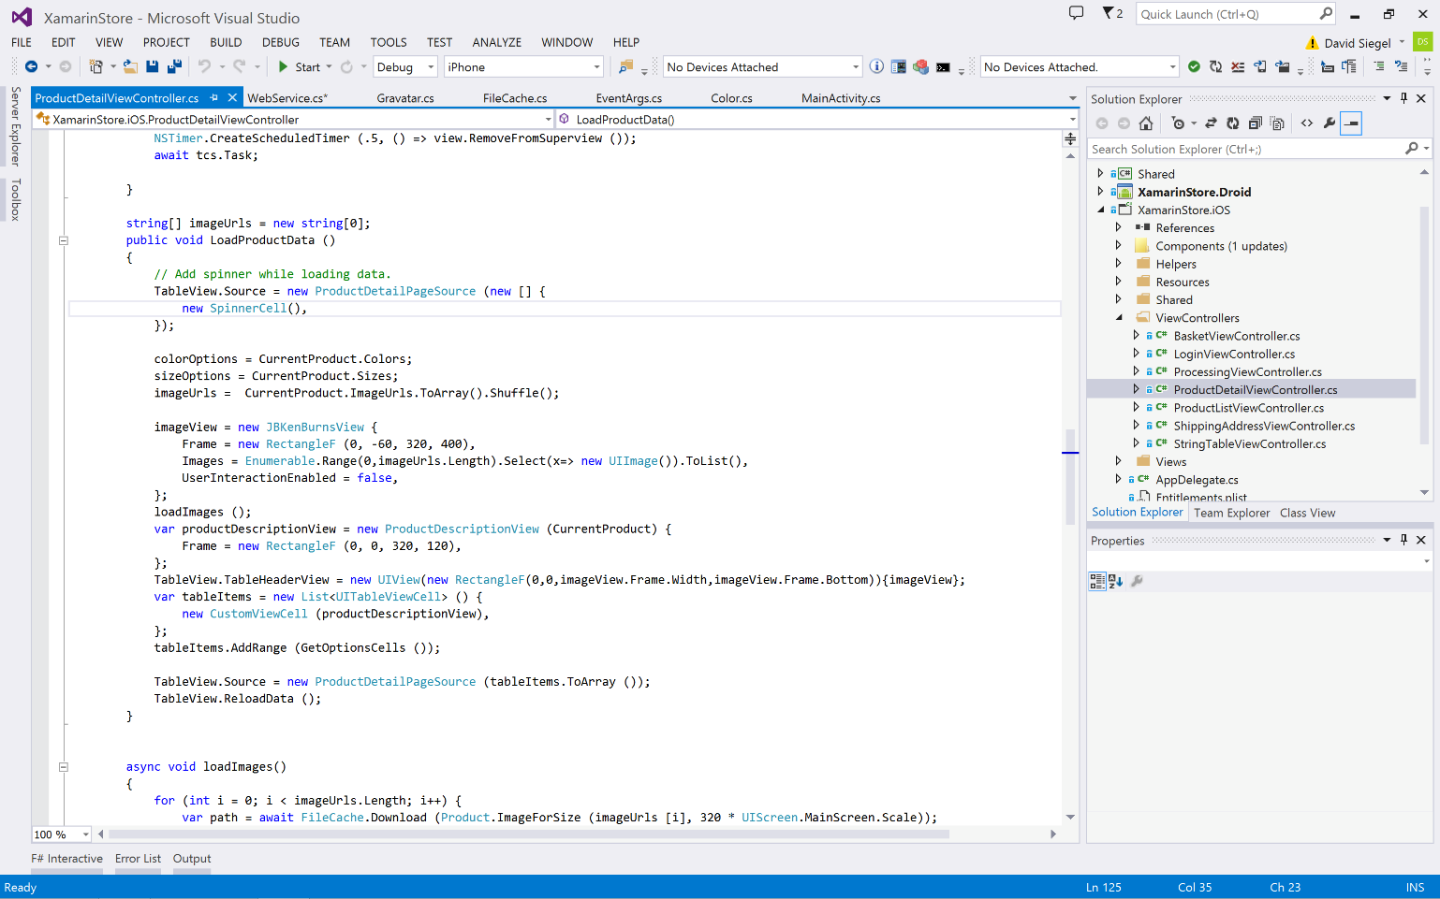
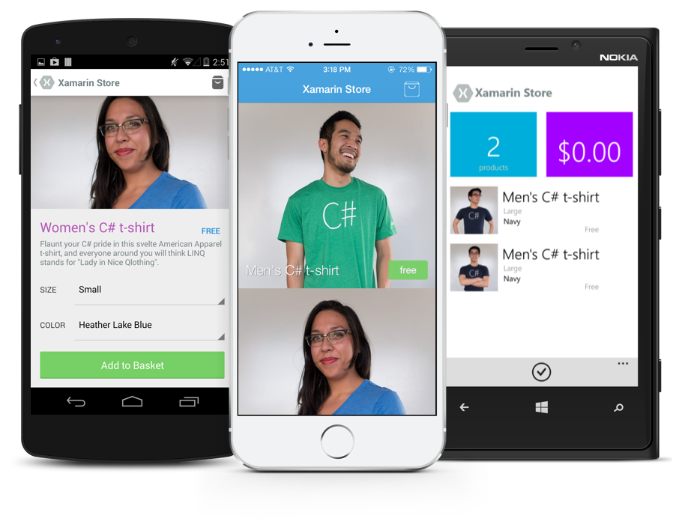
Anything you can do in Objective-C, Swift, or Java can be done in C# and Visual Studio with Xamarin.
Notes:
Coming up next is bubbles

Slide 21
✓Always Up-to-Date
Same-day support:
iOS 5
iOS 6
iOS 7
iOS 8
iOS 9
iOS 10
Full support for:
Apple Watch
Android Wear
Amazon Fire TV
Google Glass
and much more

Slide 22
Development Experience

Slide 23
Xamarin is included in Visual Studio
Xamarin is included
in Visual Studio
Including Community Edition!

Slide 24
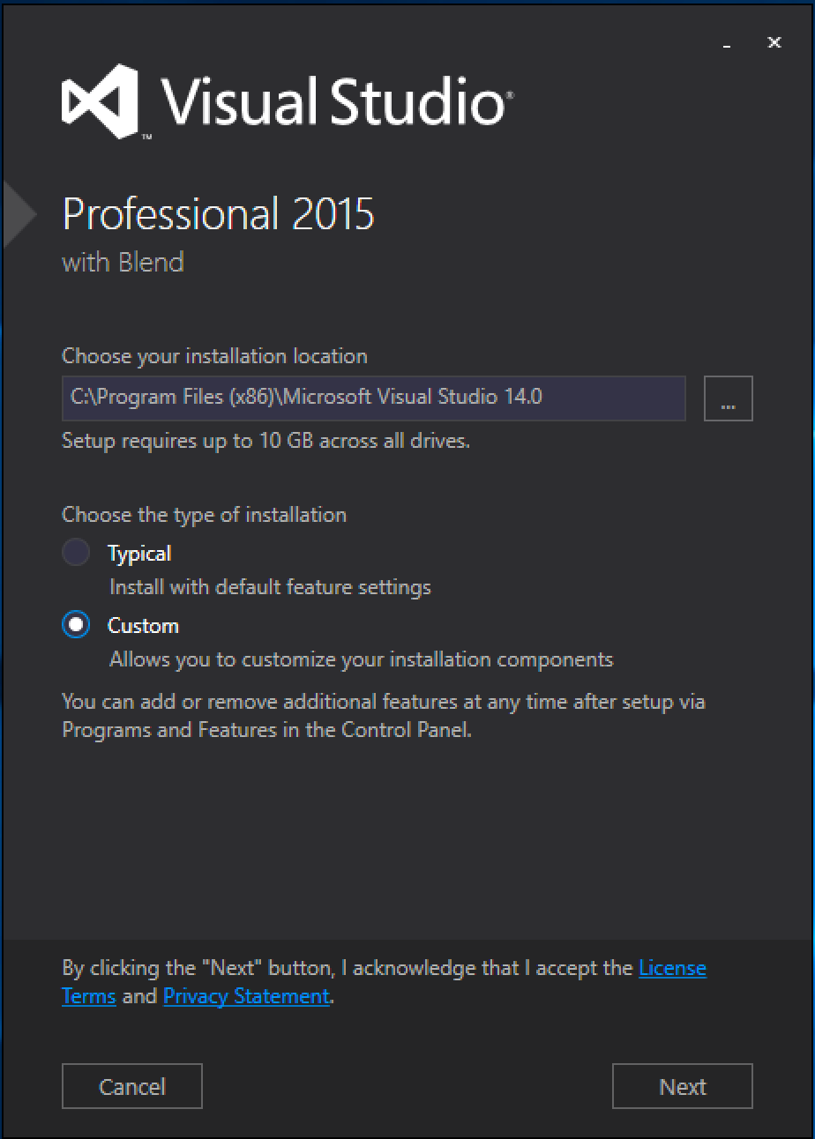
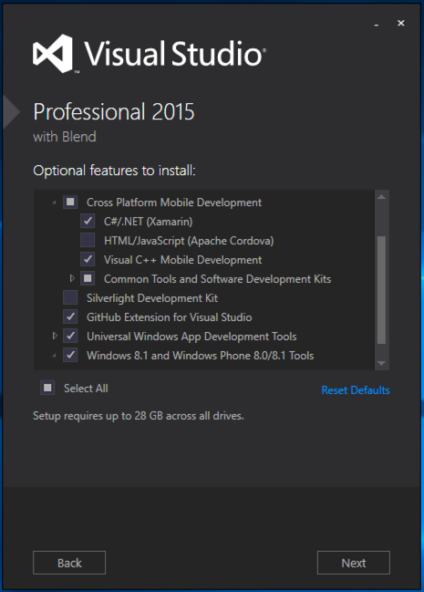
Visual Studio Integration
Xamarin.com/Download

Slide 25
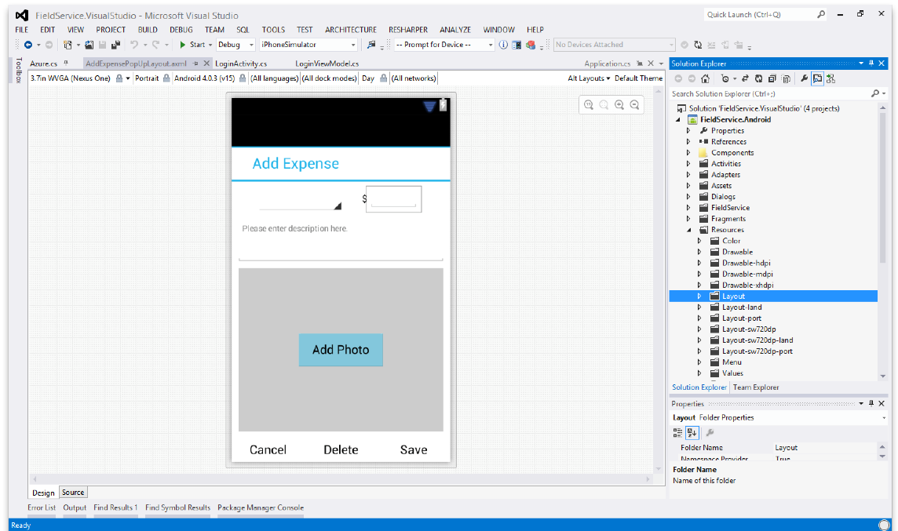
Android Designer
Create UI with drag & drop simplicity
Target multiple screen sizes, resolutions and Android versions
Layouts saved in standard Android XML files

Slide 26
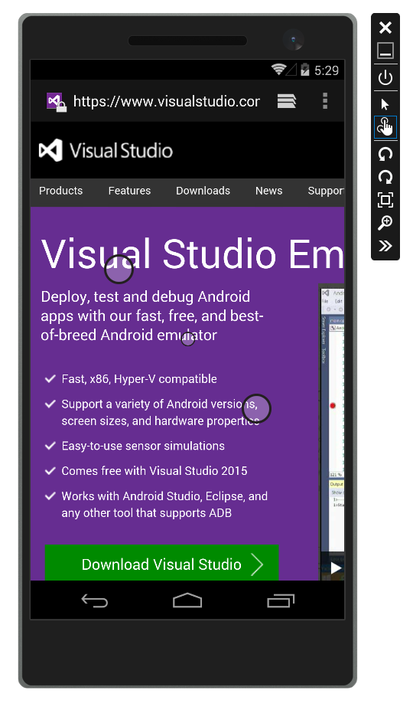
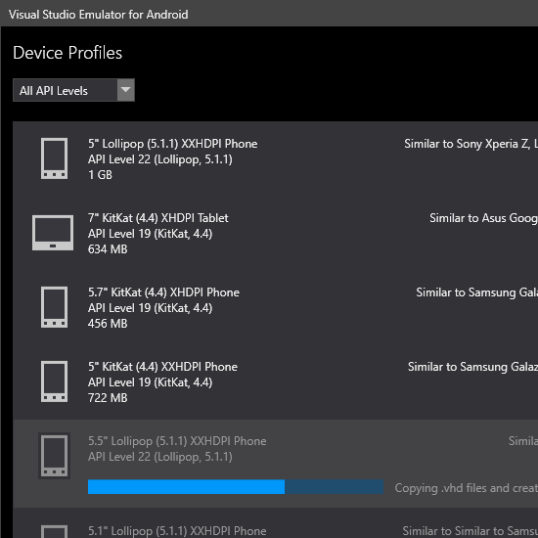
Android Hyper-V Emulators for PC
Multi-Touch Enabled
Super Fast
Rotate, screenshots, location changes, and more!
http://bit.ly/hyperv-android

Slide 27
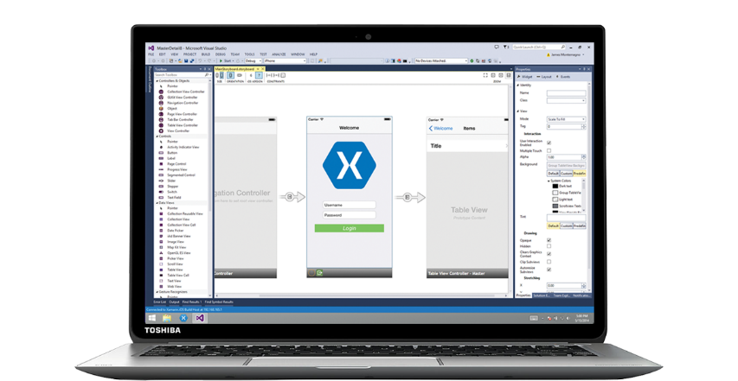
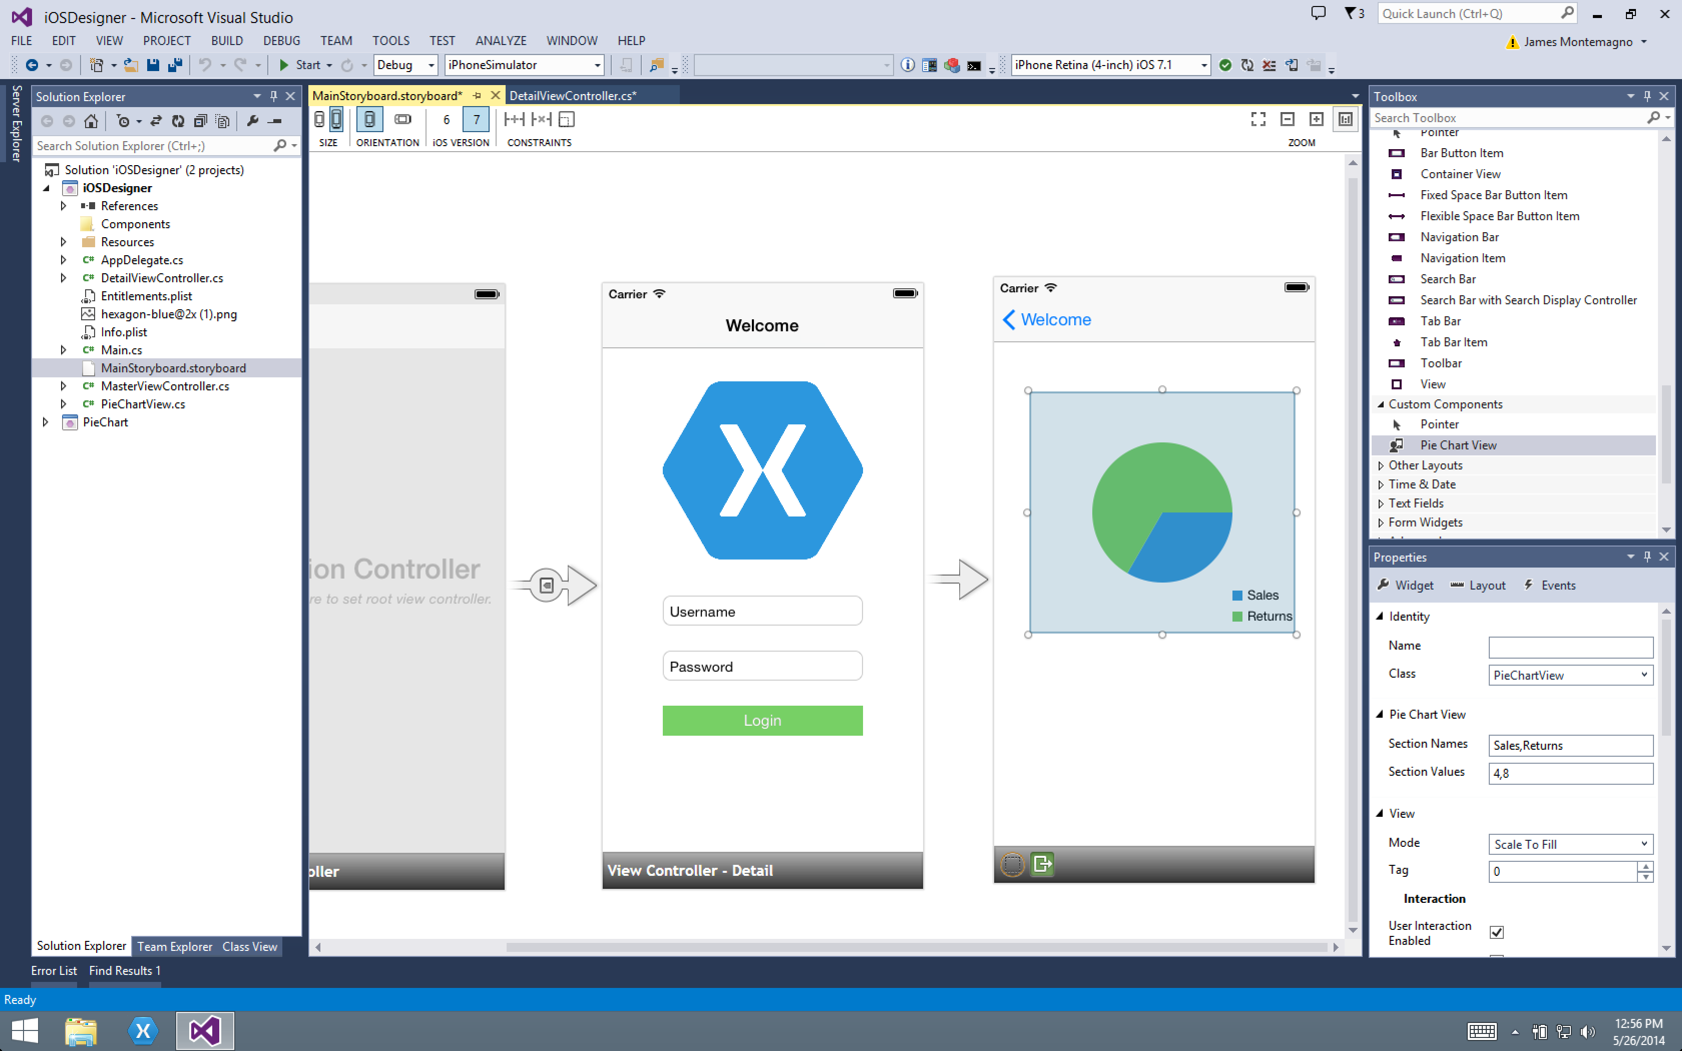
Xamarin Designer for iOS
Follows familiar Visual Studio designer idioms
Supports all UIKit elements
Edit custom and 3rd party components
Live preview of changes to properties

Slide 28

Visual Studio iOS Simulator Remoting
Multi-Touch Enabled
Pressure Sensitive
Super Fast
Rotate, screenshots, location changes
Never leave VS
*available as a preview

Slide 29
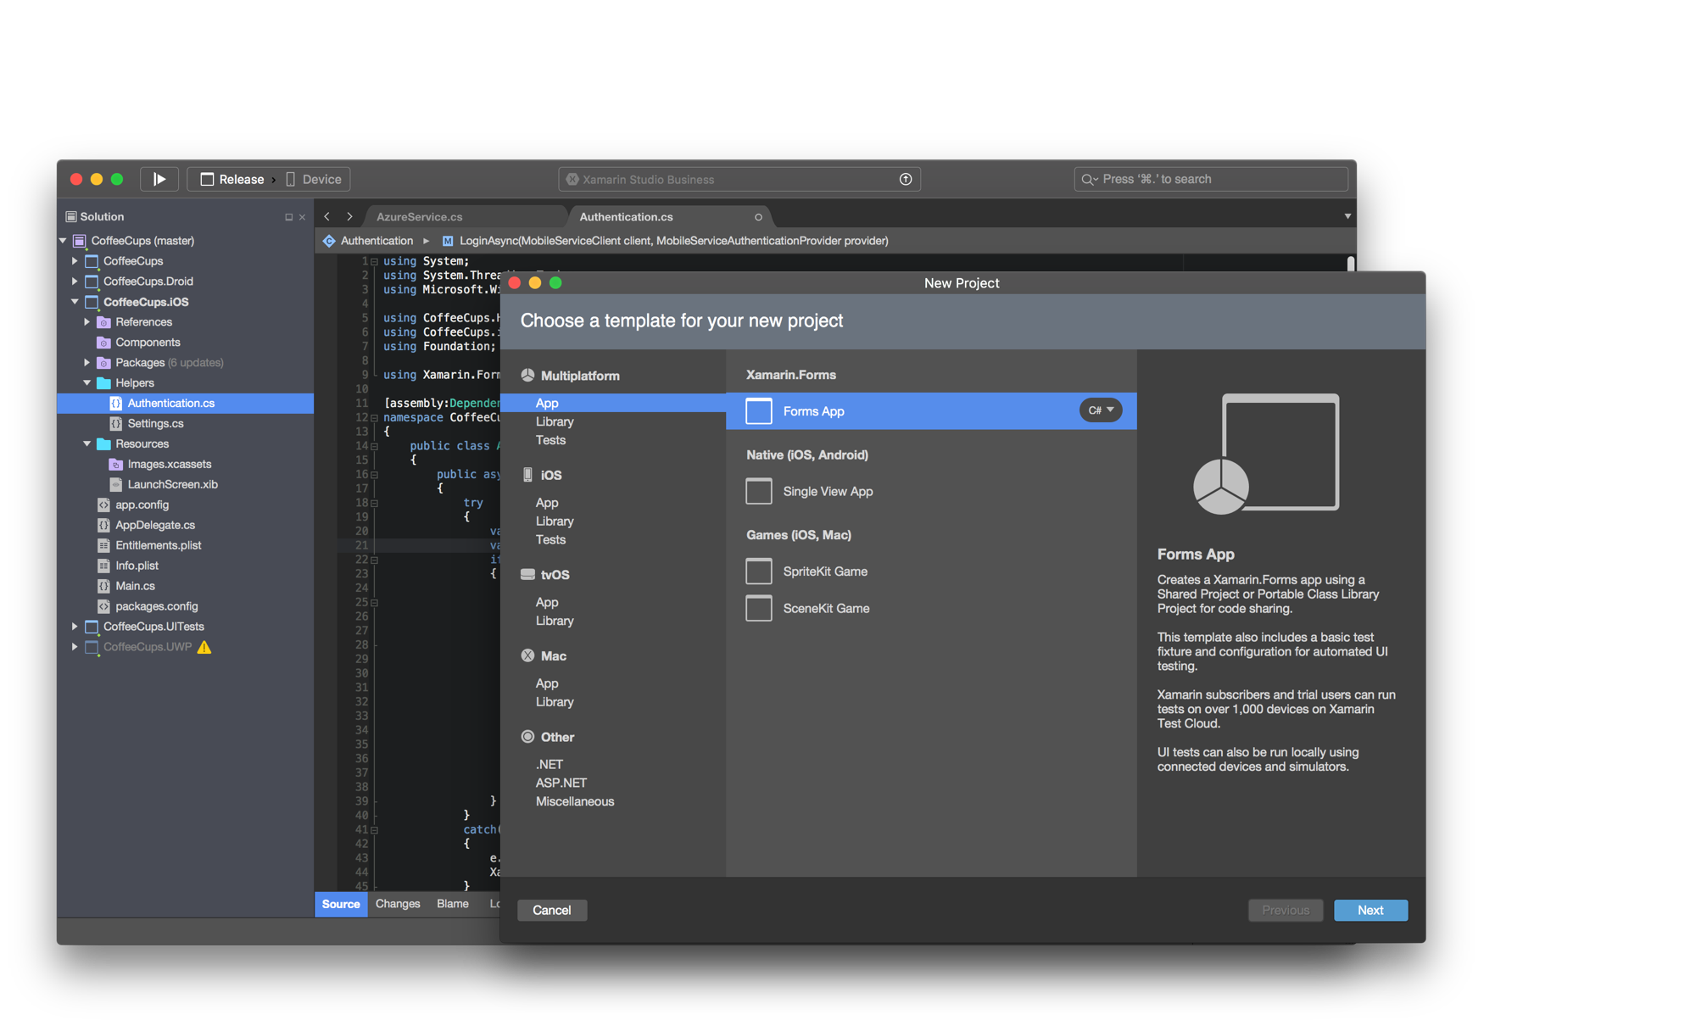
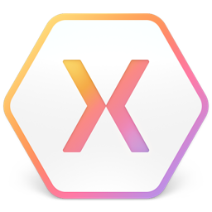
Xamarin Studio – Mac
Notes:
Xamarin Studio on Mac offers: Android, iOS and Mac development
World Class IDE with great features:
Code Analysis
Upload to Test Flight
Git & Subversion Integration
Code Completion
Code Navigation
Easy transition from Visual Studio
The same Solution & Projects open in BOTH Xamarin Studio and Visual Studio!

Slide 30
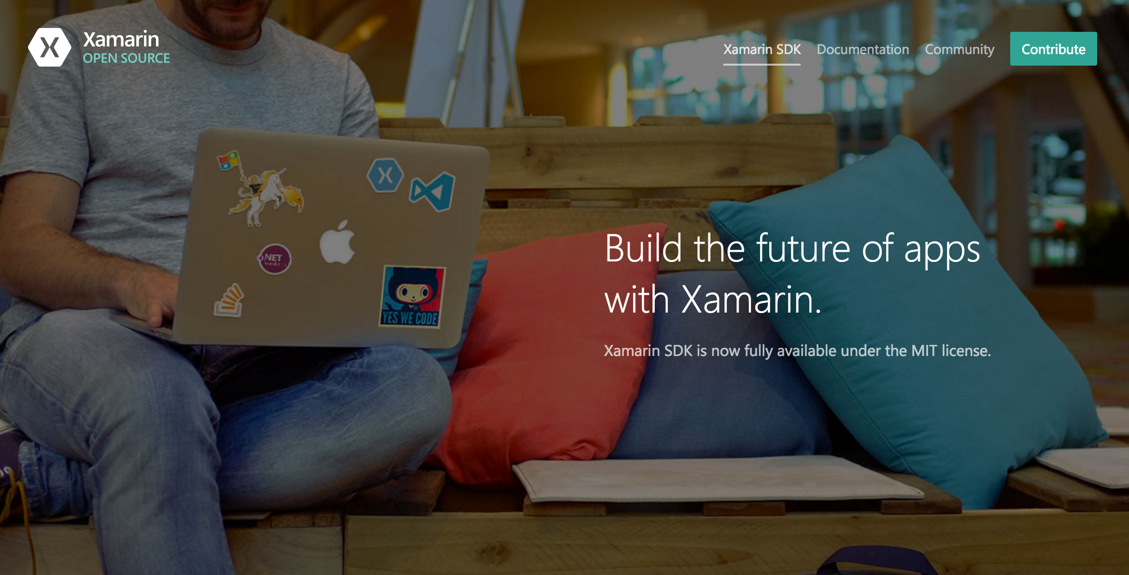
Open Source – open.xamarin.com

Slide 31
Sharing Code

Slide 32
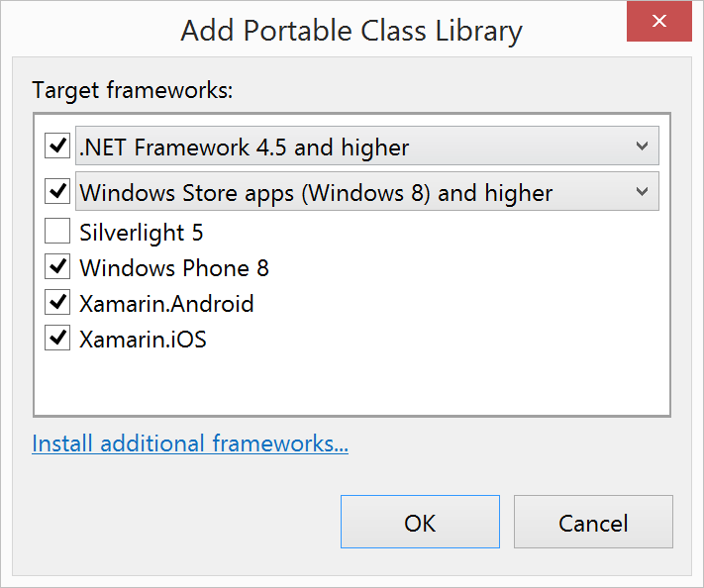
Portable Class Libraries
1 Assembly
Multiple Platforms
Including:
Xamarin.iOS and Xamarin.Android

Slide 33
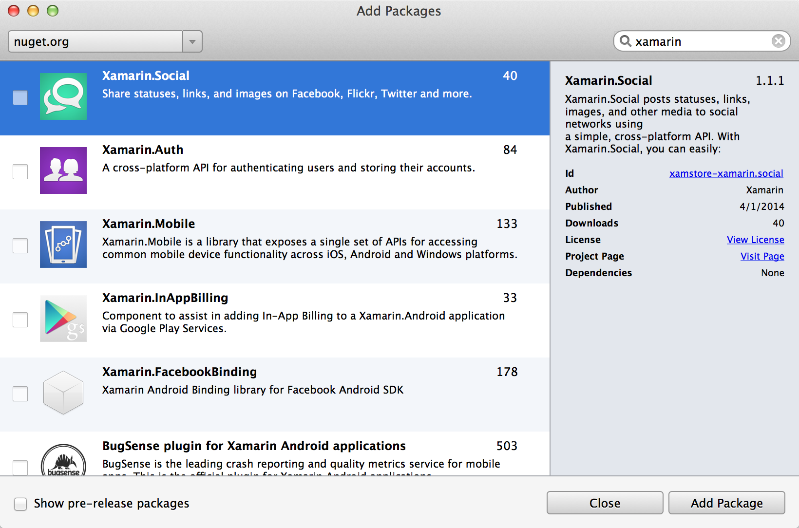
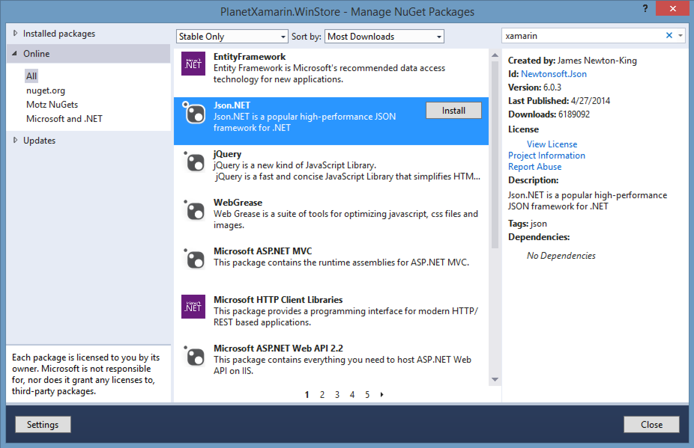
NuGet

Slide 34
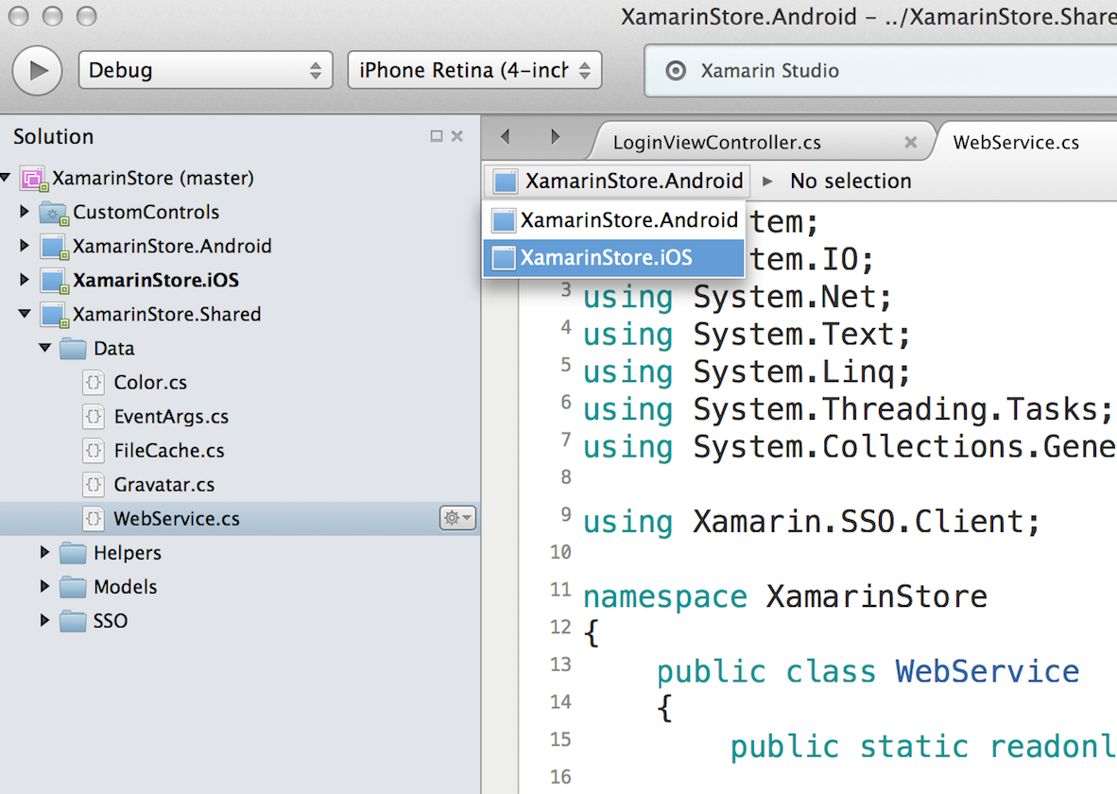
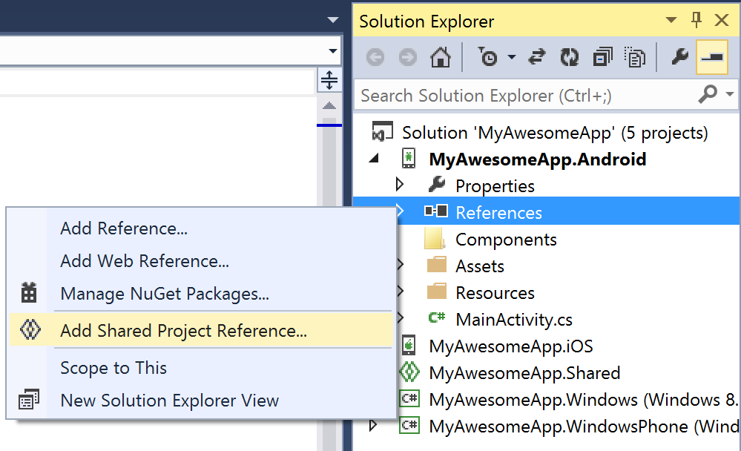
Shared Projects

Slide 35
Code Sharing Stats
Calca
iCircuit
Touch Draw
Android
iOS
Mac
Windows Phone

Slide 36
Let’s Build an App

Slide 37
Simplifying Development

Slide 38
Shared C# Backend

Slide 39
Platform Specific Code
UI+APIs
UI + APIs
UI + APIs
Battery
GPS
Lights
Notifications
Settings
Text To Speech
Battery
GPS
Lights
Notifications
Settings
Text To Speech
Battery
GPS
Lights
Notifications
Settings
Text To Speech
What if we didn’t have to write this code?
What if we could access it from shared code?

Slide 40
Speak(“Hello World”);
AVSpeechSynthesizer
TextToSpeech
SpeechSynthesizer

Slide 41
Plugins for Xamarin
github.com/xamarin/plugins
Common API

Slide 42
10 Minute Break
Presenter First Name
Presenter Last Name
Presenter Title
Presenter e-mail
blogs
Twitter

